Slide 1
Cybernetix Case Study,
New ETMCC,
CSL model checking improvements
Operating statement
Ivan Zapreev

Slide 2



Chronology
Aug. 2004 – Current
MCC model checker
Jun. 2004 – Aug. 2004
Cybernetix Case Study
Mar. 2004 – Jun. 2004
Learning literature

Slide 3
The Cybernetix Case Study.
Probabilities and Non-determinism.
Ivan Zapreev

Slide 4
Outline
The Cybernatix Case Study
The main interest
Considered Models
Conclusions
Future works

Slide 5
The Cybernatix Case Study
Personalization stations
Load cards
Unload cards
Belt

Slide 6
Main interests
Involve probabilistic and/or non-deterministic failures
Types of failures
  A card can be broken
  A personalization station can be broken
P(M of N cards are broken) = ?

Slide 7
Super Single Mode
Do everything as fast as you can, and leave free space for personalized cards.
Give uniform loading of stations
Personalization stations
Load cards
Unload cards
Belt

Slide 8
Considered models
A.S.
1. Each card can be broken with a constant probability.
2. Each card can be broken with an increasing
probability. Weibull distribution.
3. Station breaks with a constant probability and breaks
[0,…,K] cards. Non determinism.
4. Station breaks with a constant probability and breaks a
constant number of cards.
A.S.
5. Station can break while working, needs constant time to
be repaired.
6. A simple DTMC, there is a probability to break and a
probability to be repaired

Slide 9
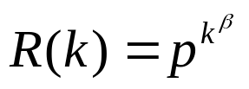
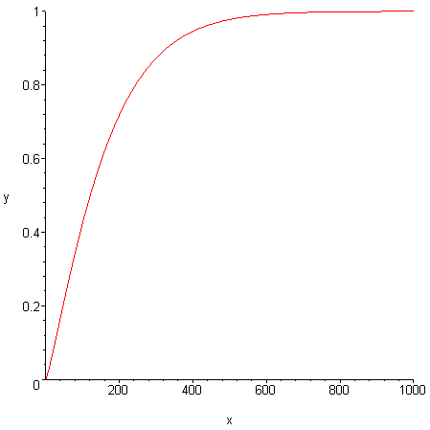








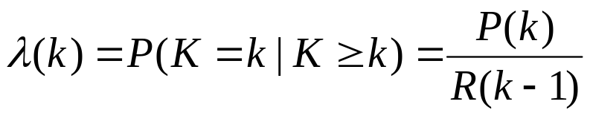
Type I discrete Weibull distribution
- reliability function
- failure rate
Increasing Failure Rate distribution
probability of failure at demand k
- probability not to fail during k demands
- probability to fail at demand k if it did not fail before.

Slide 10


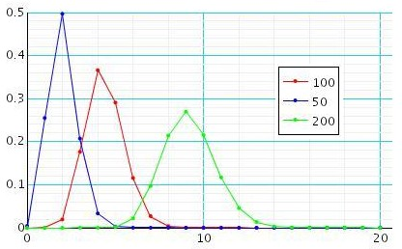
Simple Failure Model with Weibull distribution of failures
The model: Each card can be broken while personalization
with the probability
with
where k is
the number of cards, correctly personalized, by the given station since it broke card for the last time.
P
N =
M

Slide 11




One station results generalization
Uniform stations loading (SSM)
Independent station failures
Time
Loading station
Unloading station
Belt
4 personalization
stations
- the total amount of cards
- the number of stations, is the divisor of N
- the probability for one station

Slide 12
Conclusions
Different failure models were investigated,
Analytical solutions were discovered,
“One station” “Any number of stations”;

Slide 13
Future works
Check whether the SSM still provides optimal throughput of good cards when probabilistic failures are involved.
Model:
  Non determinism on the level of scheduling
  Probabilistic breakings of personalization
  stations
Use Prism tool customized for finding an optimal schedule.

Slide 14
MCC model checker.
A reincarnation of ETMCC.
Ivan S Zapreev,
Maneesh Khattri

Slide 15
Outline
Goals
PRCTL & CSRL
Details
ETMCC vs. MCC
Conclusions
Future works

Slide 16


Goals
Develop a unified framework for
PCTL, CSL, PRCTL and CSRL,
Make it work faster than ETMCC,
  Use more efficient data structures,
  Use improved algorithms for CSL,
    Steady state detection,
    Faster until operators,
    Faster BSCCs search,
    ETC….;

Slide 17
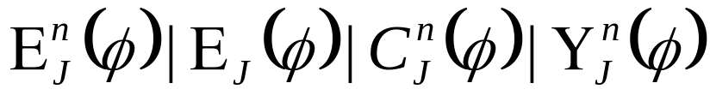

PRCTL & CSRL
PRCTL:
CSRL:

Slide 18

Details
Data structures:
  Sparse Matrix special representation,
  Fast Matrix Vector multiplication,
  Linear memory allocation,
  Predecessor sets,
Algorithms:
  Direct search only for required BSCCs,
  Efficient algorithms for bounded until,
  Efficient algorithms for unbounded until,
  Collapse states,
  On the fly steady state detection,
  Store transient state probabilities of
  reaching BSCCs,
  Bisimulation minimization;

Slide 19
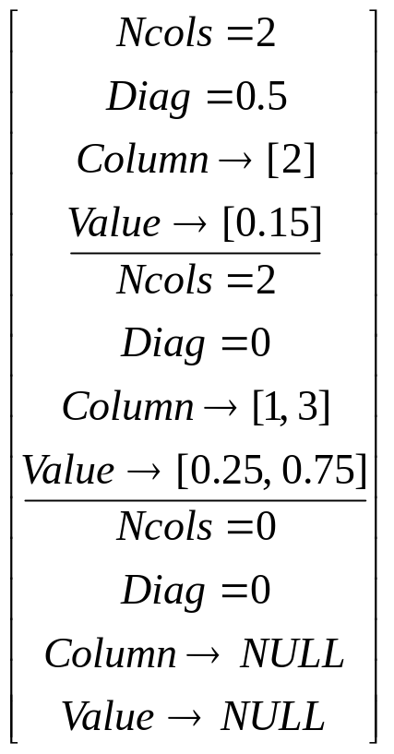
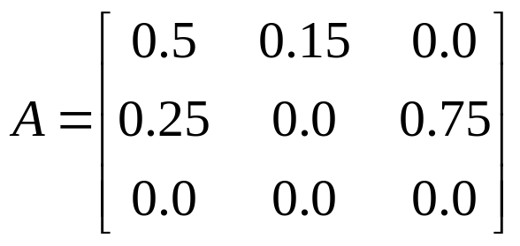
Data Structure
Make states absorbing
Compute Uniformized DTMC from CTMC

Slide 20
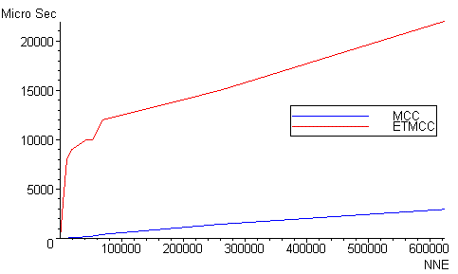
ETMCC vs. MCC
Matrix vector multiplication:
! MCC is about 9 times faster !

Slide 21
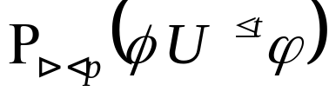
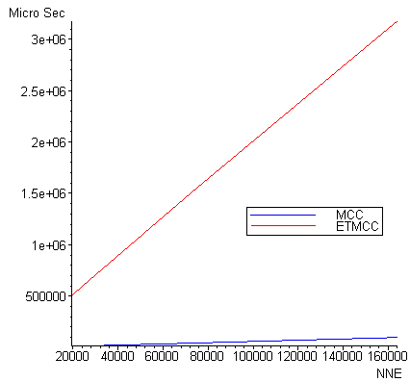
ETMCC vs. MCC
The Cluster Computing example
http://www.cs.bham.ac.uk/dxp/prism/cluster.html
! MCC is at least 3 times faster !

Slide 22

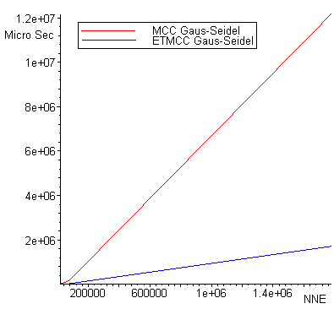
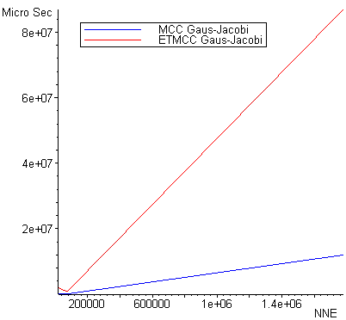
ETMCC vs. MCC
The Cluster Computing example
http://www.cs.bham.ac.uk/dxp/prism/cluster.html
! MCC is from 4.0 to 8.9 times faster !

Slide 23
Conclusions
The PCTL, CSL, PRCTL logics are supported,
The implementation is several times faster,
There are still ways for further improvements;

Slide 24
Future works
Incorporate CSRL logic model
checking,
Work on future improvements of
algorithms for CSL,
  On the fly steady state detection,
  Store transient state probabilities of
  reaching BSCCs,
  Collapse states,
  Involve bisimulation minimization;

Slide 25
CSL model checking improvements
Ivan S Zapreev,
Maneesh Khattri

Slide 26
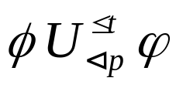

Outline
CSL logic
The operator
Krylov Subspaces
Matrix exponent estimate
The estimate
Conclusions
Future works

Slide 27
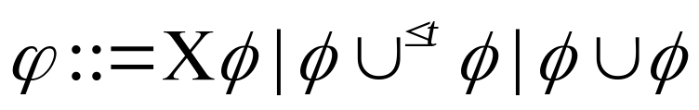

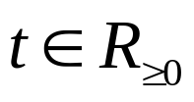

CSL logic
The syntax of CSL:
Where
,
,

Slide 28
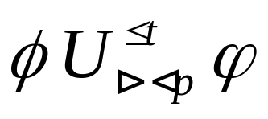
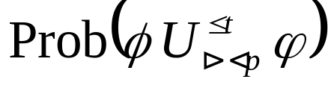
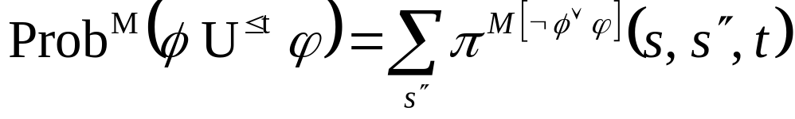
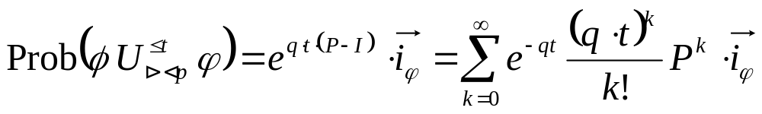
The operator
The
can be computed as:
The solution:
Using uniformisation:

Slide 29
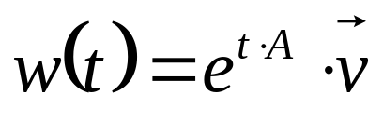
Krylov Subspaces
The probability
is just a transient probability and is obtained as a solution of a differential equation. The solution is given in the for of matrix exponent.
Krylov-based algorithm:
Computes matrix exponential multiplied by vector at once as an approximation of w(t) by mapping the solution onto a much smaller subspace.

Slide 30
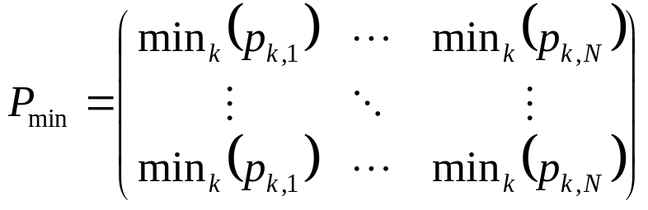
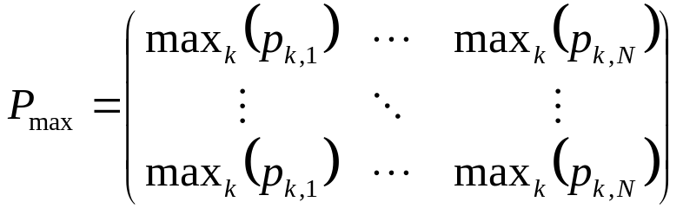
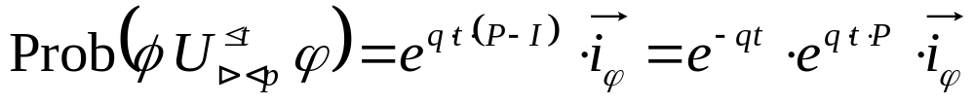
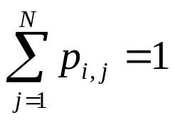

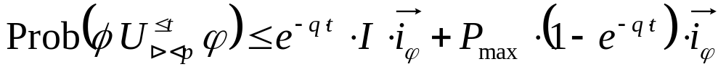
Matrix exponent estimate
Unfortunately this estimate
does not work ☹
&
?
?
?

Slide 31
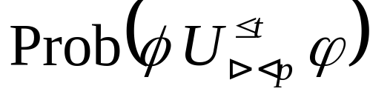

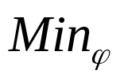


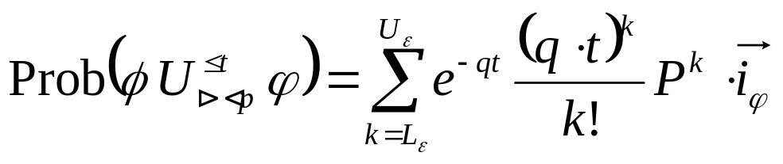
The estimate
Idea 1:
In DTMC consider all transitions leading to state only once and collect probability only of some paths. This will give us some estimate.
Idea 2:
In DTMC compute Min estimate of reaching
state. This will give us max estimate
Idea 3:
The ideas 1 & 2 give Min and Max estimate for DTMC. The estimates for CTMC can be gathered with the using the formula & Fox-Glynn algorithm:

Slide 32
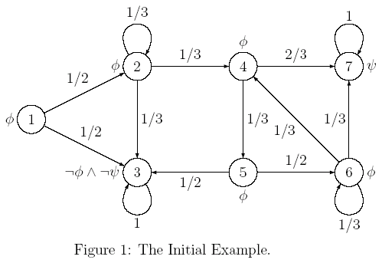
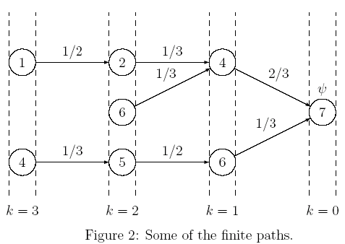





Example for the estimate

Slide 33
Conclusions
Several possible ways of model checking improvement are under consideration, the work is in progress!

Slide 34
General Conclusions
The Cybernetix Case Study,
The CSL model checking improvements,
The new version of ETMCC;

